Slide 1
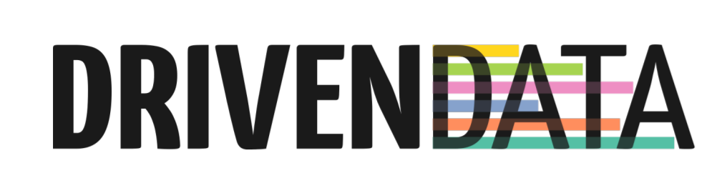
PUMP IT UP – Predictive Analytics for Water Pumps in Tanzania
Samuel King

Slide 2
Agenda
The Knowledge Discovery Process
Data exploration
Data cleaning
Feature creation
External source augmentation
Models
Evaluation
Conclusions

Slide 3







Knowledge discovery process
External source
augmentation
Load data
Data cleaning
Feature selection
Evaluation
Exploration
Feature creation
Modelling

Slide 4
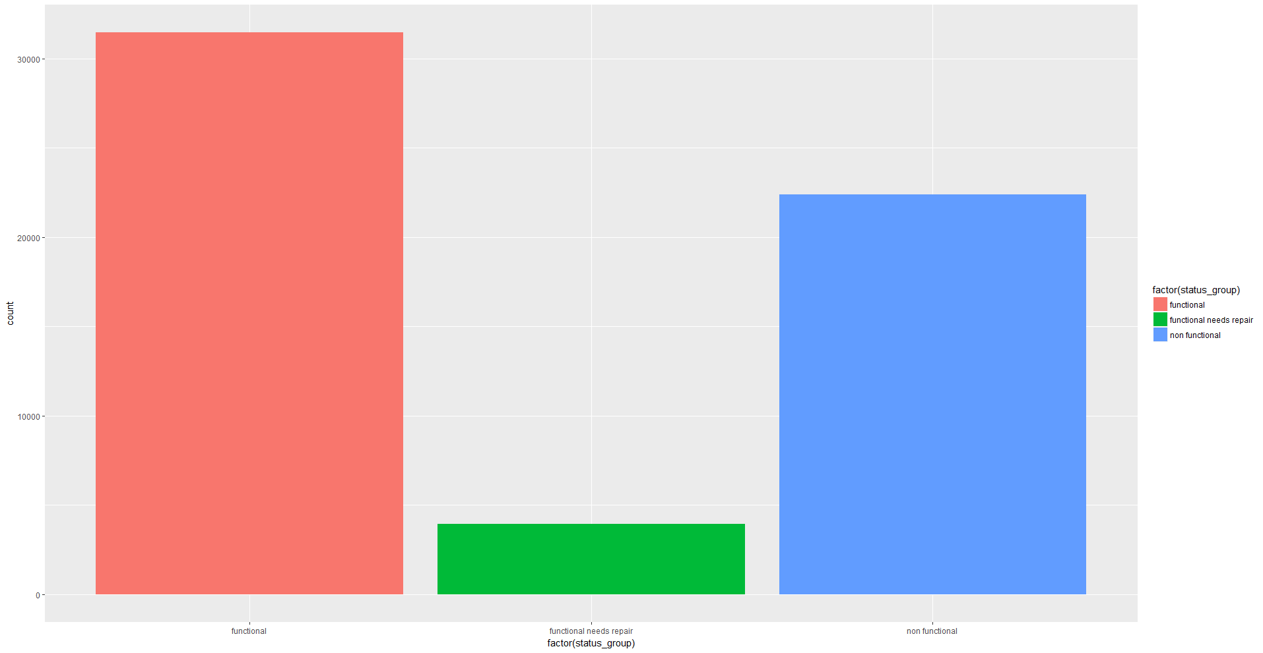
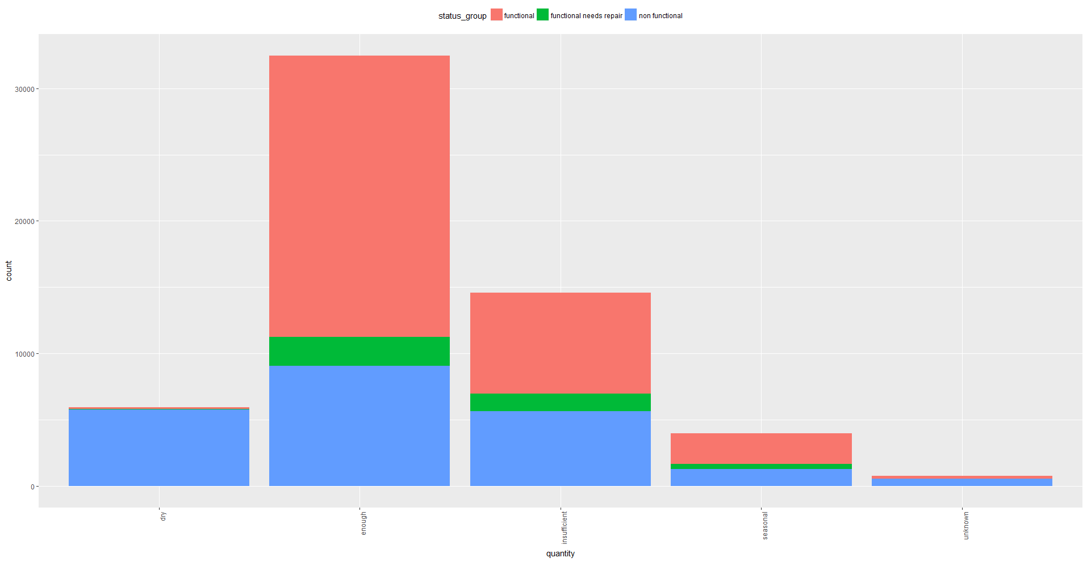
Data exploration
Target variable (status_group)
Explanatory variables (quantity)
54.3%
38.4%
7.3%

Slide 5
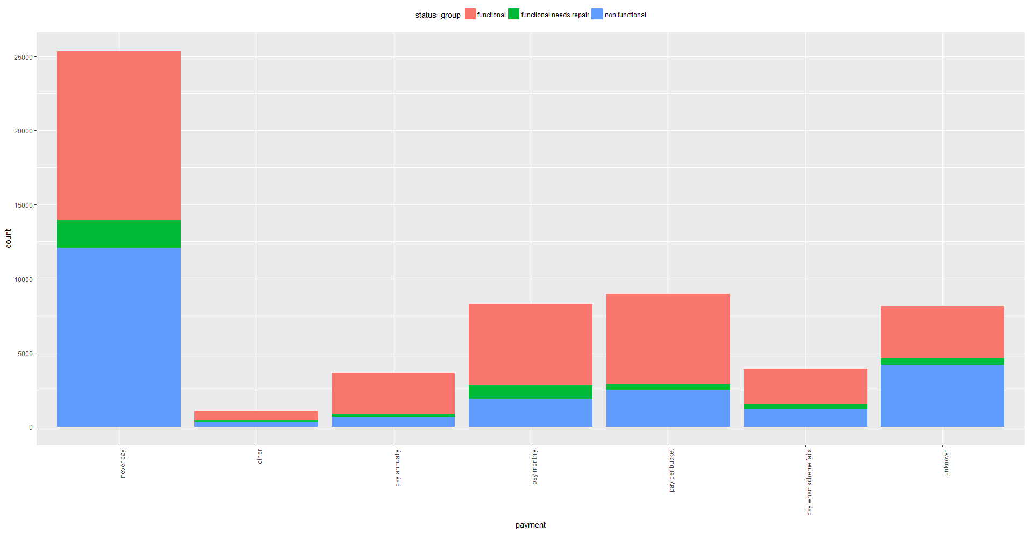
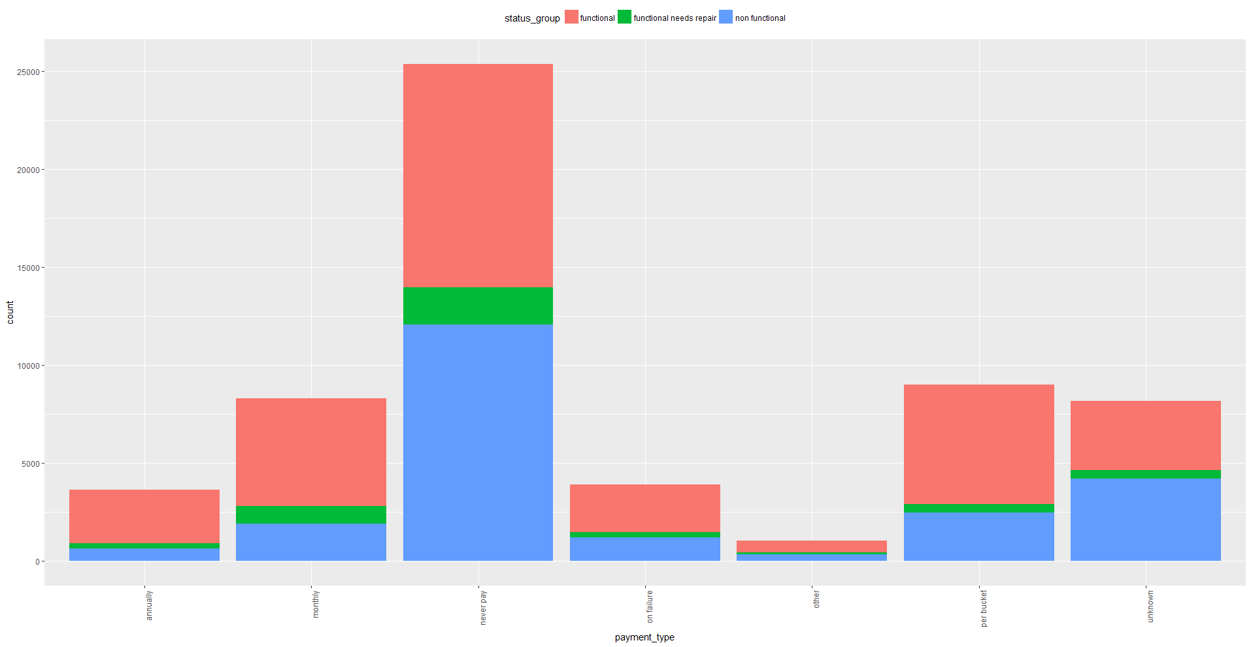
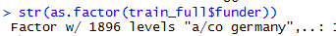
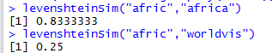
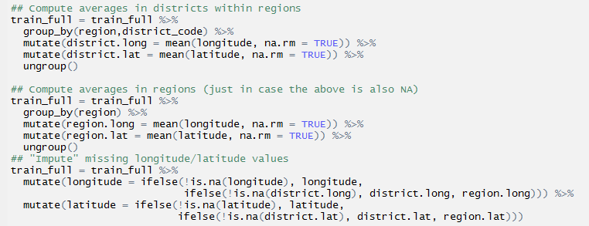
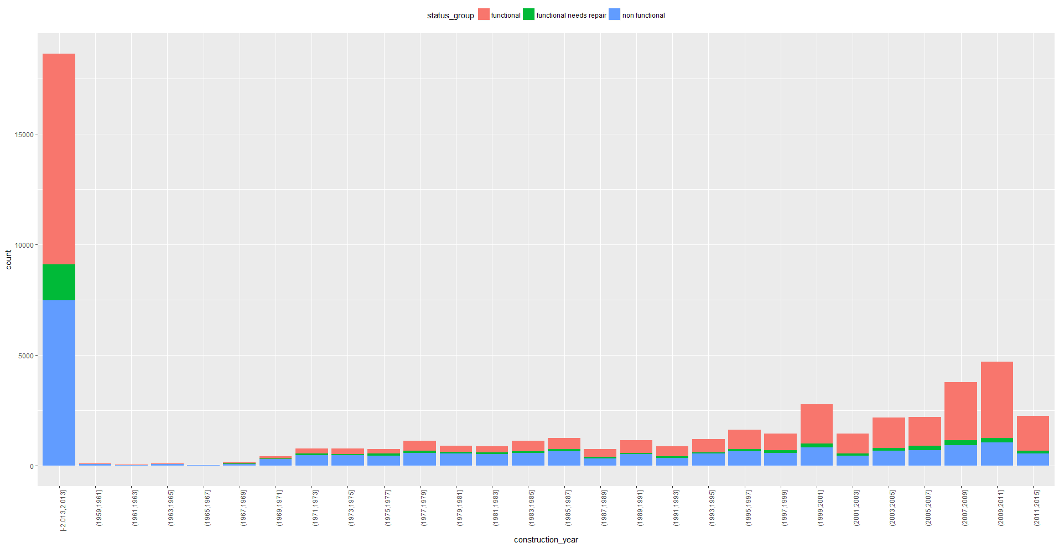
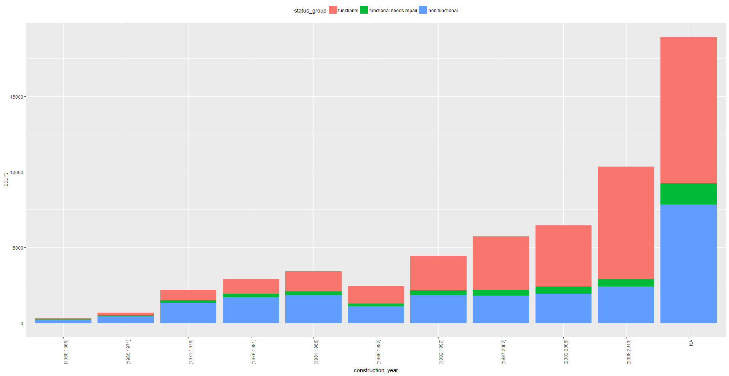
Data cleaning
Dropping variables (payment/payment_type)
Reducing factors (funder)
Removing user-missing (construction year)
Imputing system-missing (lat/long)
Year = 0?

Slide 6
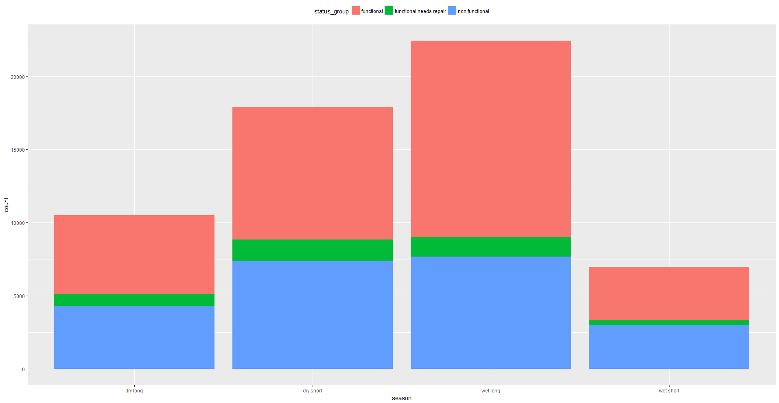
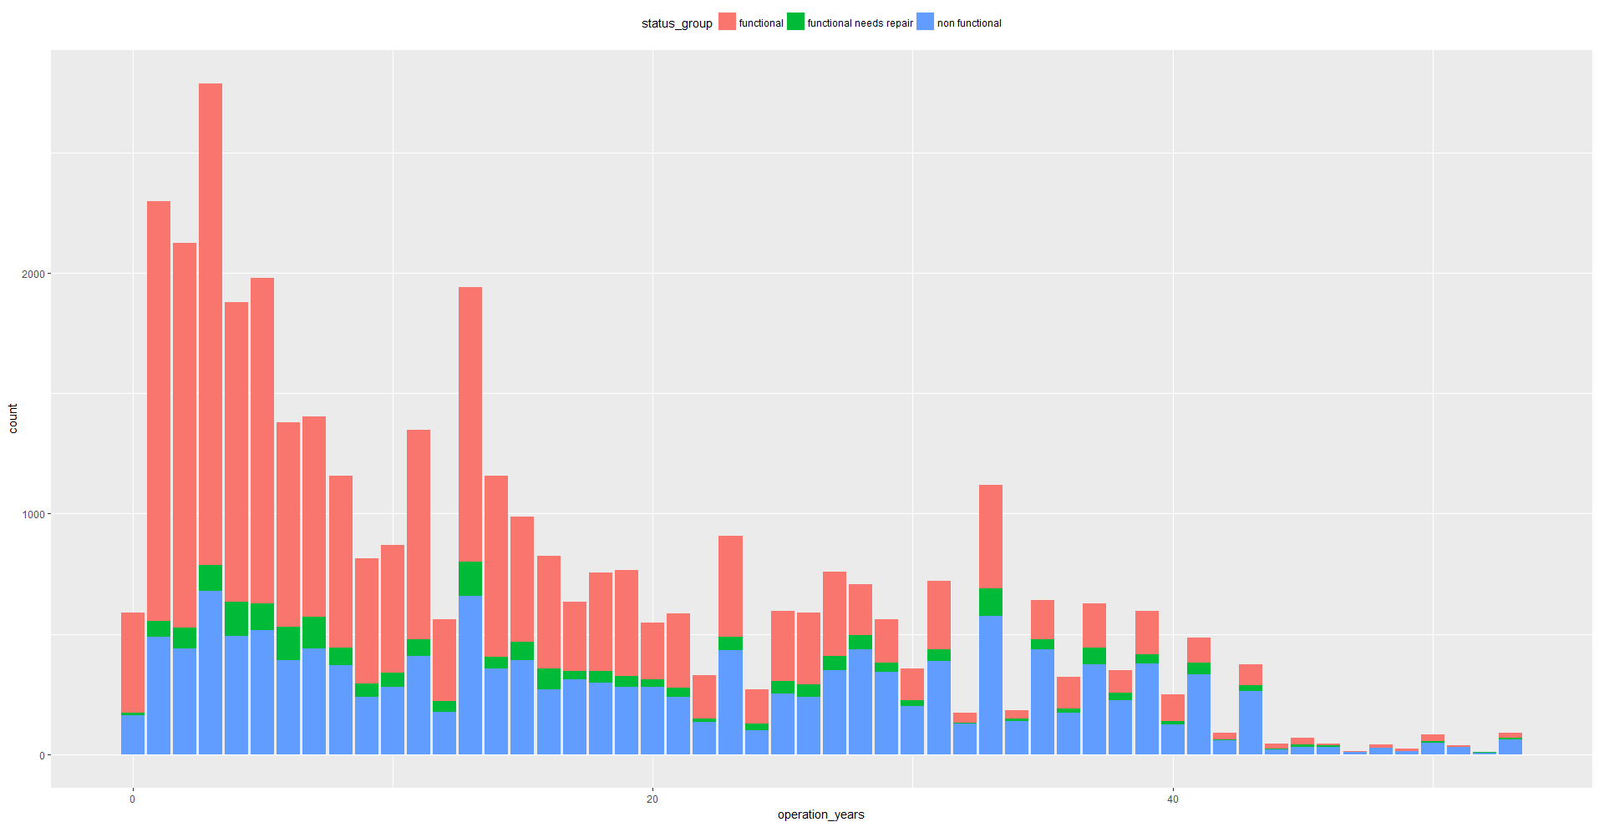
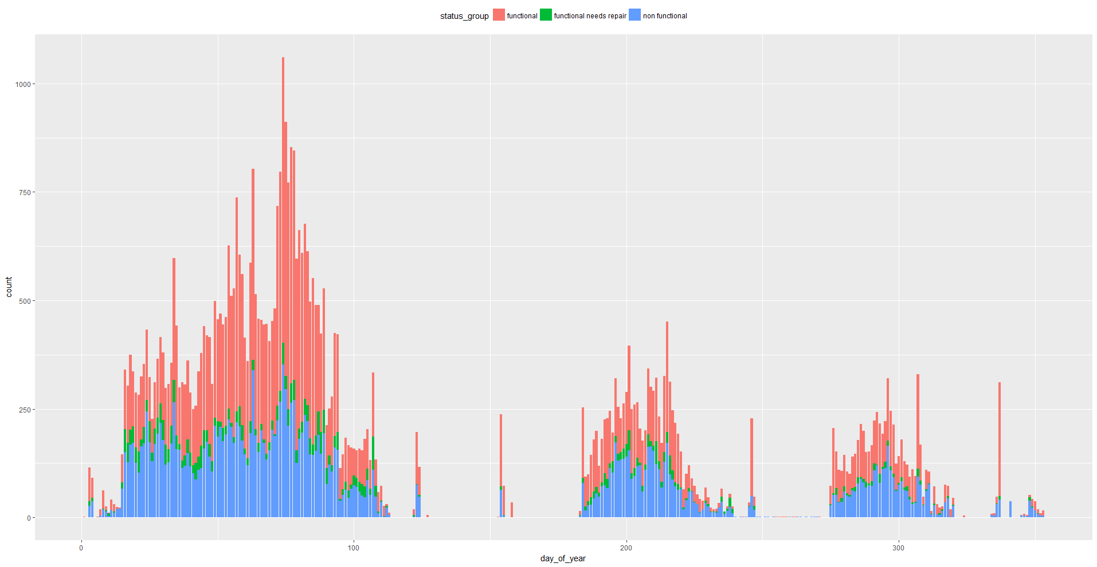
Feature creation
Day_of_the_year
Season
Season
(https://www.expertafrica.com/tanzania/info/tanzania-weather-and-climate):
*Tanzania has two rainy seasons: The short rains from late-October to late-December,
#' a.k.a. the Mango Rains, and the long rains from March to May.*
Operation_years
Day_of_the_year

Slide 7
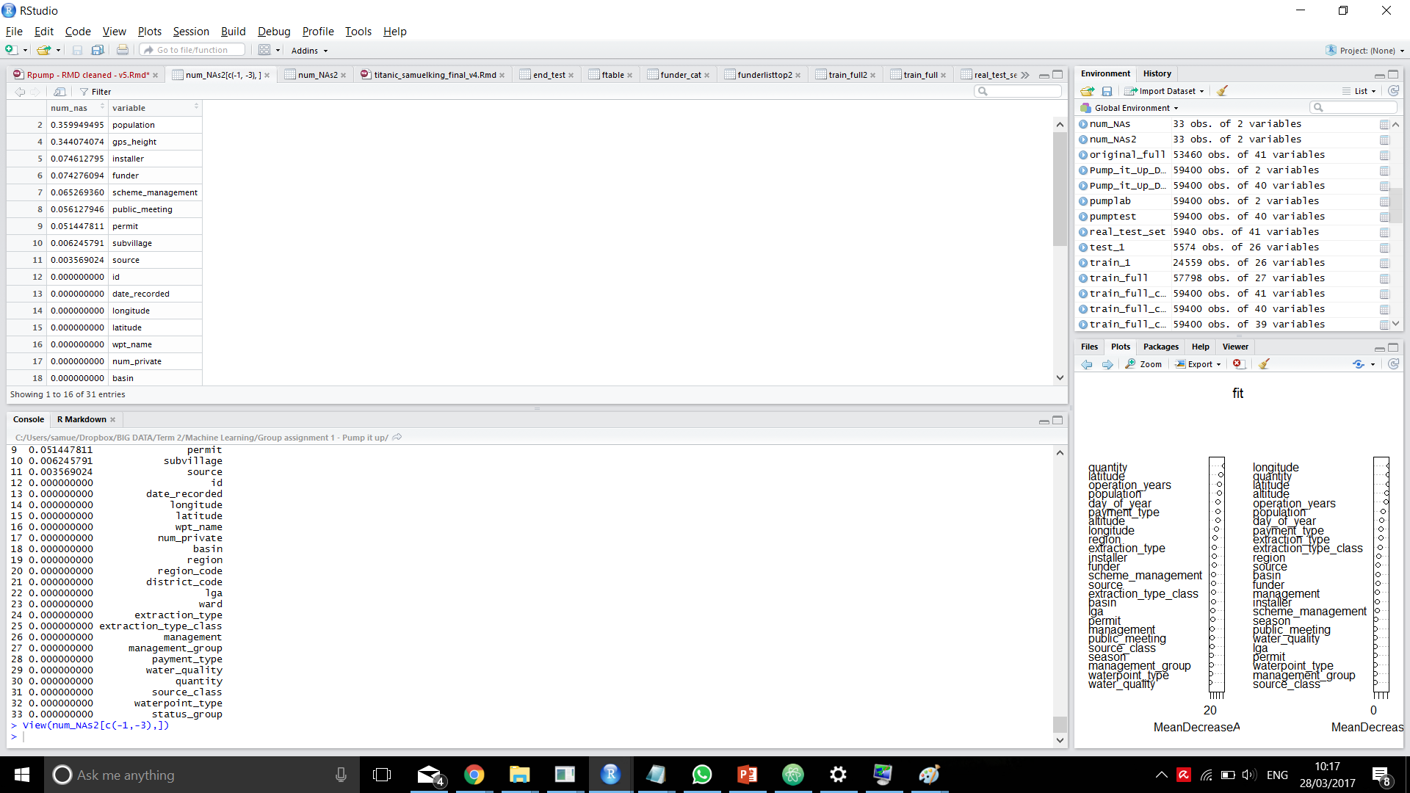
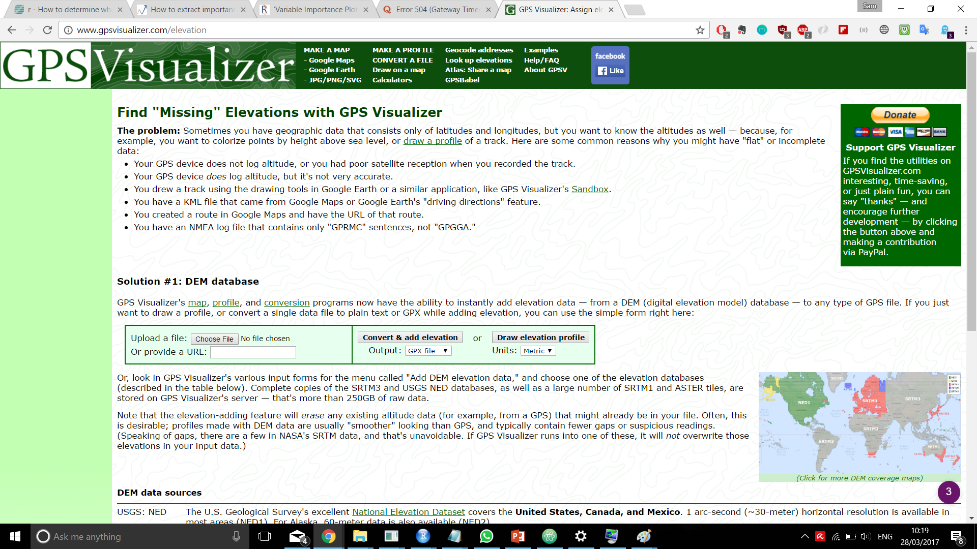
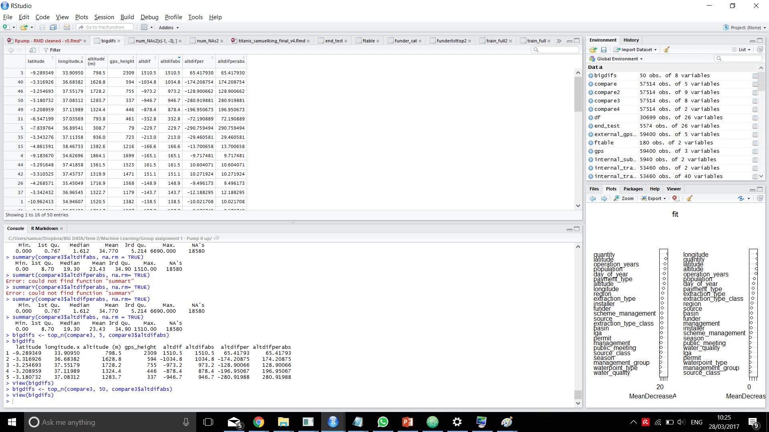
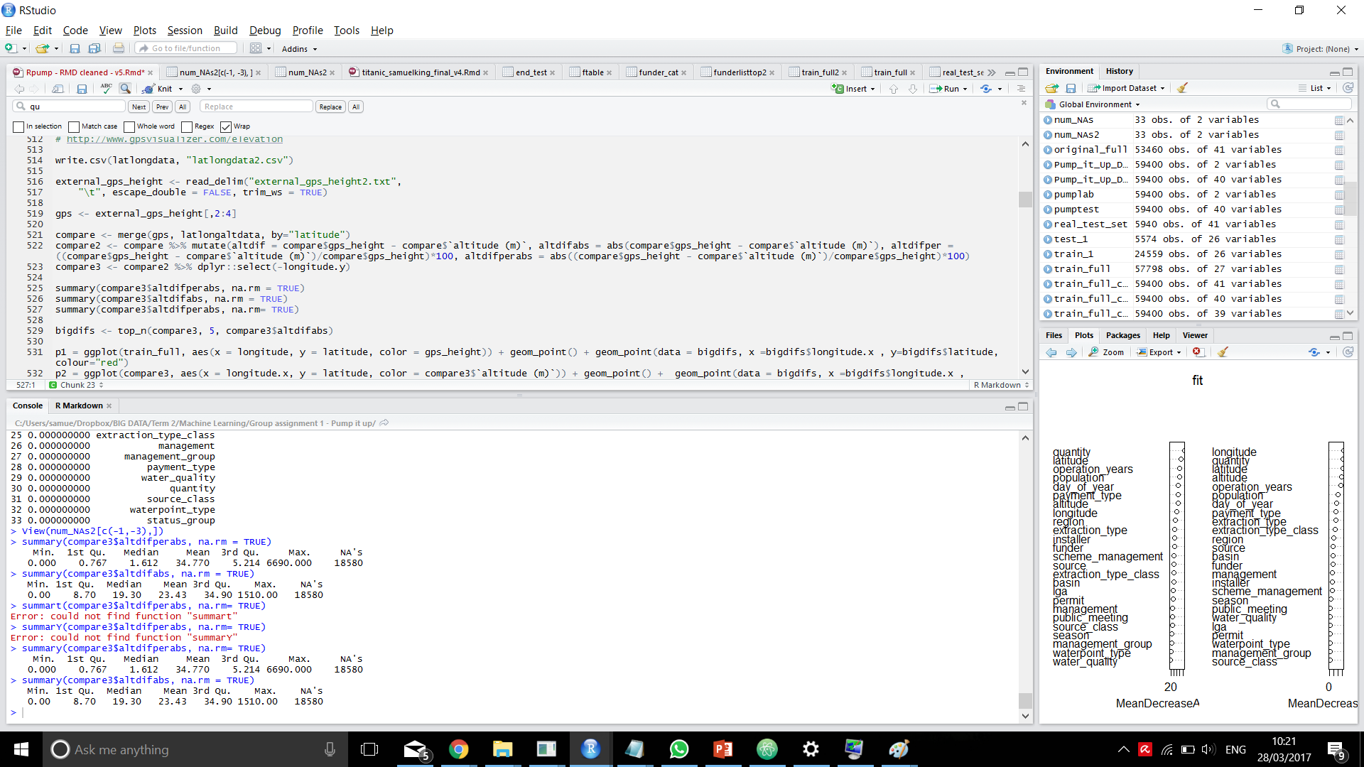
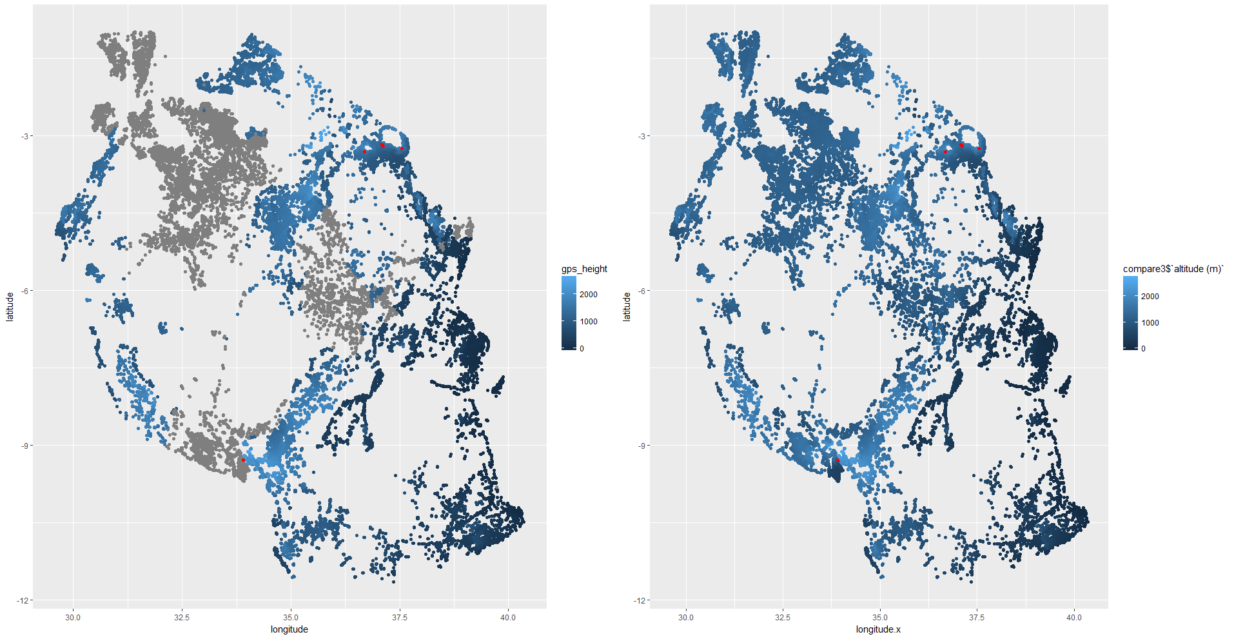
External source augmentation
Altitude
Only 5 seriously off points
Median dif: 19m (1.6%)
Mean dif: 23m

Slide 8
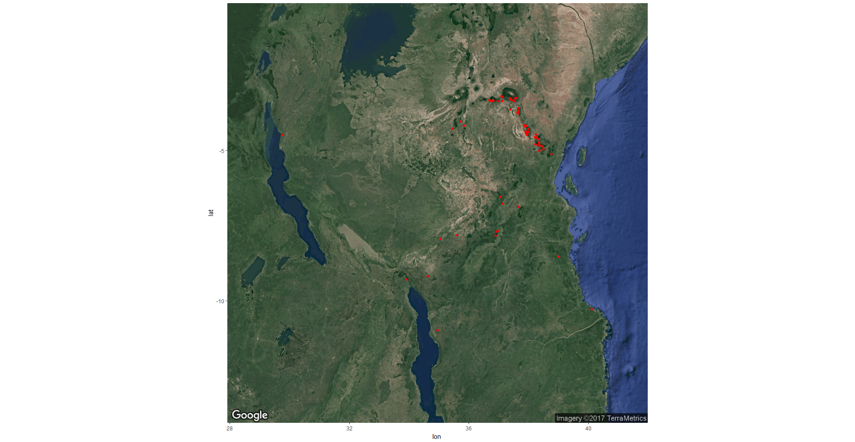
External source augmentation
Population also attempted using this approach

Slide 9
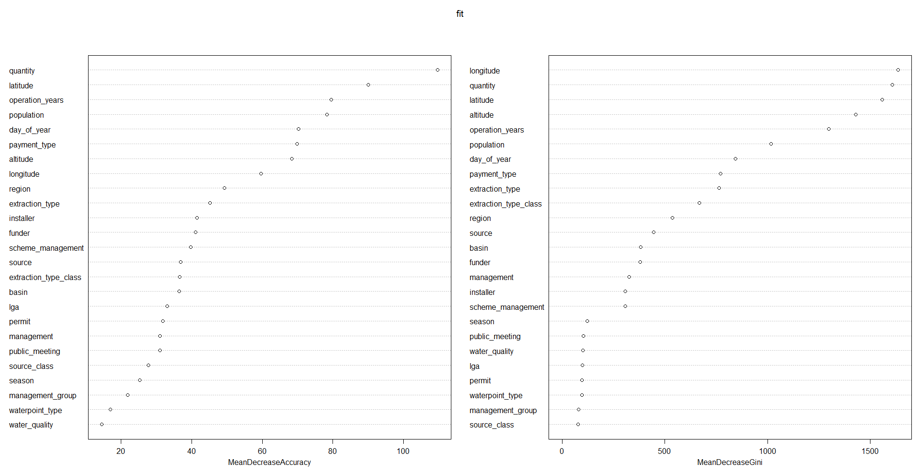
Feature selection
= Created features
= Augmented features
Same model with ‘gps_height’: 81.0%
Same model with ‘altitude’: 82.4%

Slide 10
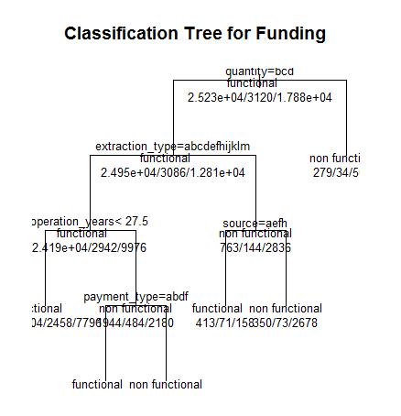
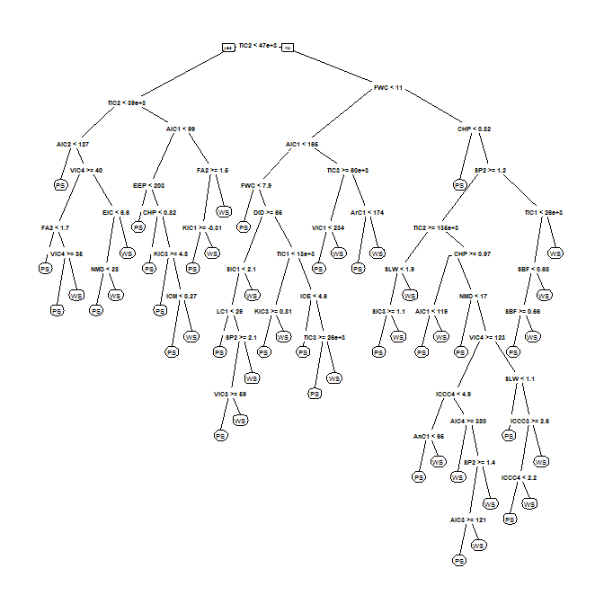
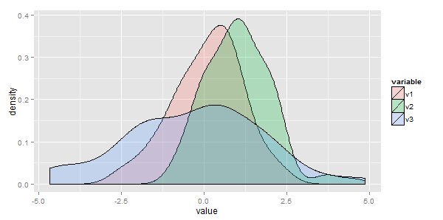
Modelling
CV: Accuracy
70.74%
Trees
Random Forest
LDA
81.19%
82.88%
78.84%

Slide 11
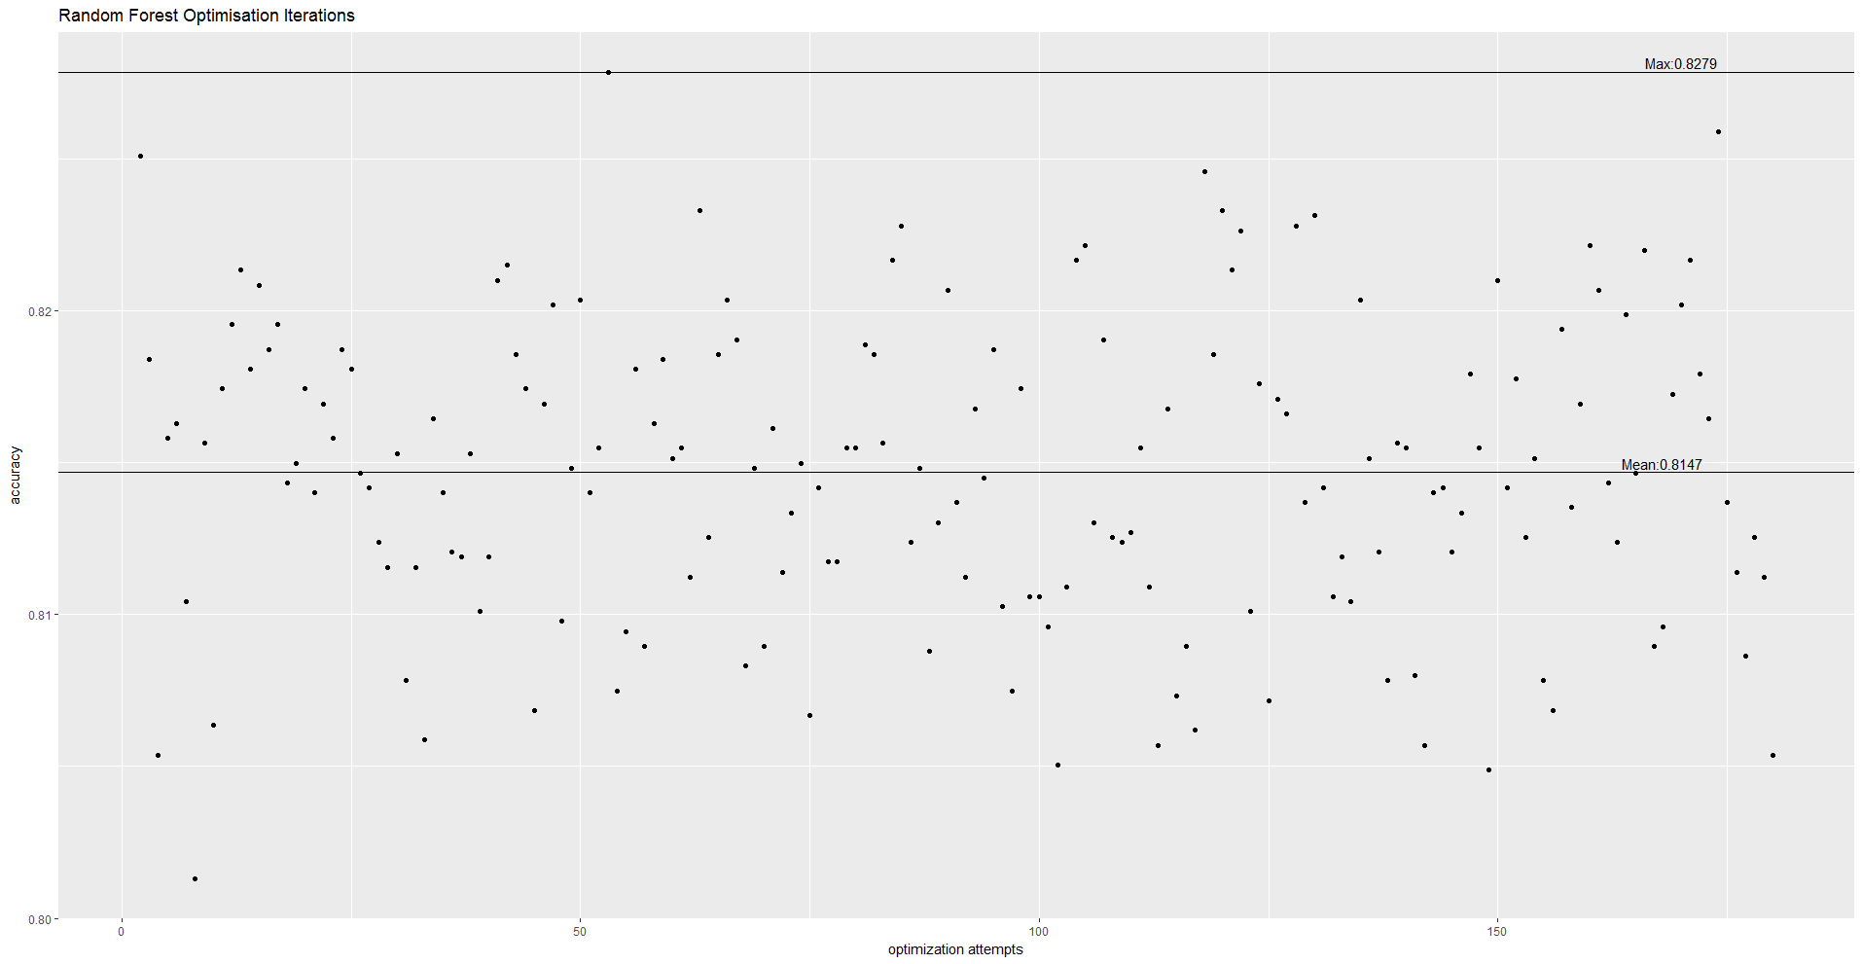
Model optimisation
82.88%
Max = 0.8279
Mean = 0.8147
Ntrees = 300, mtrys=def…

Slide 12
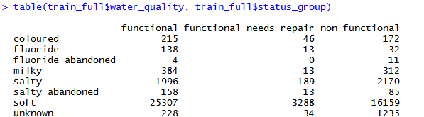
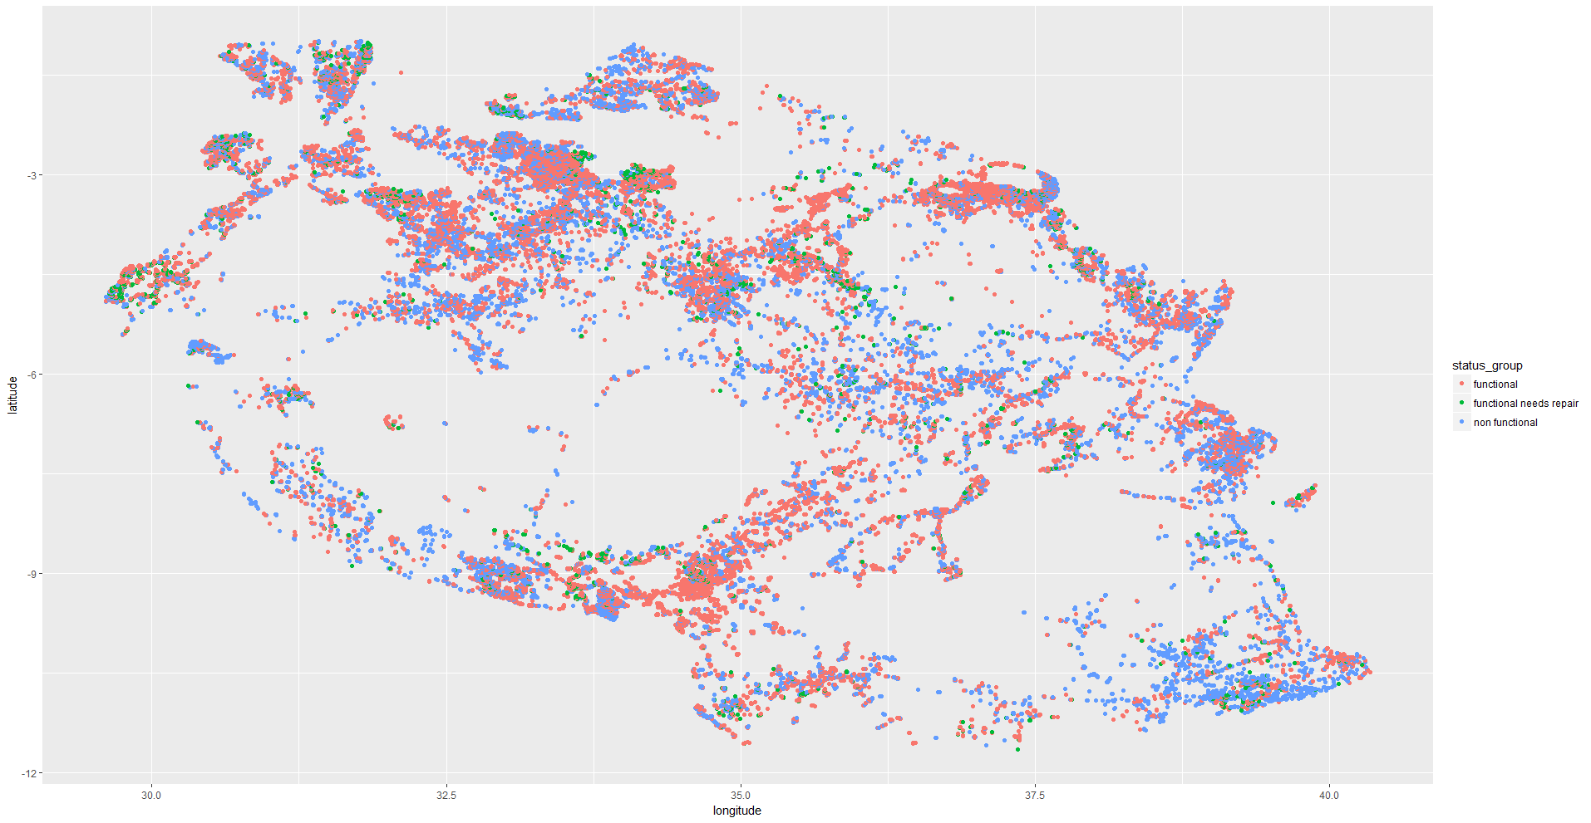
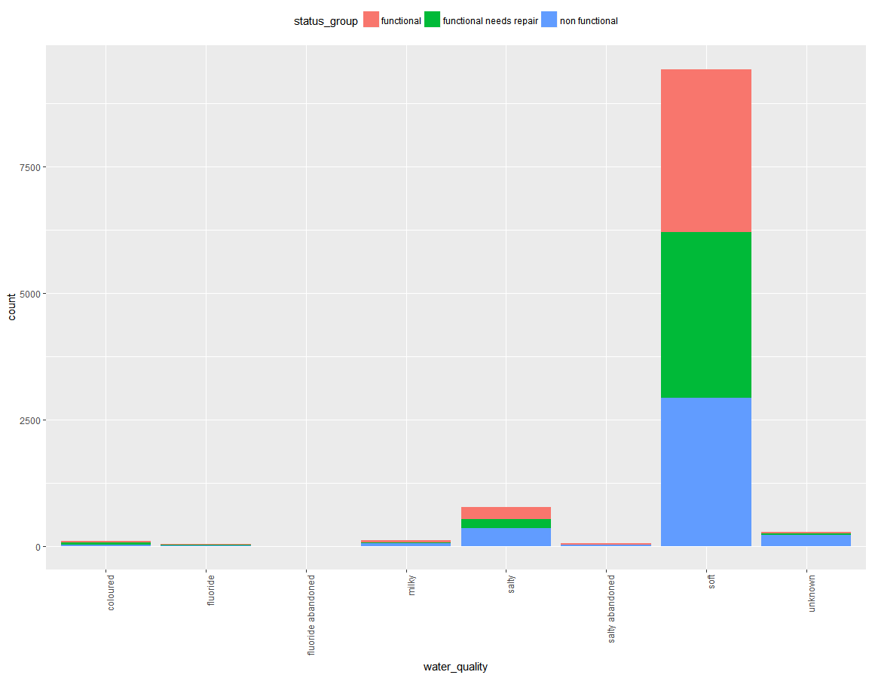
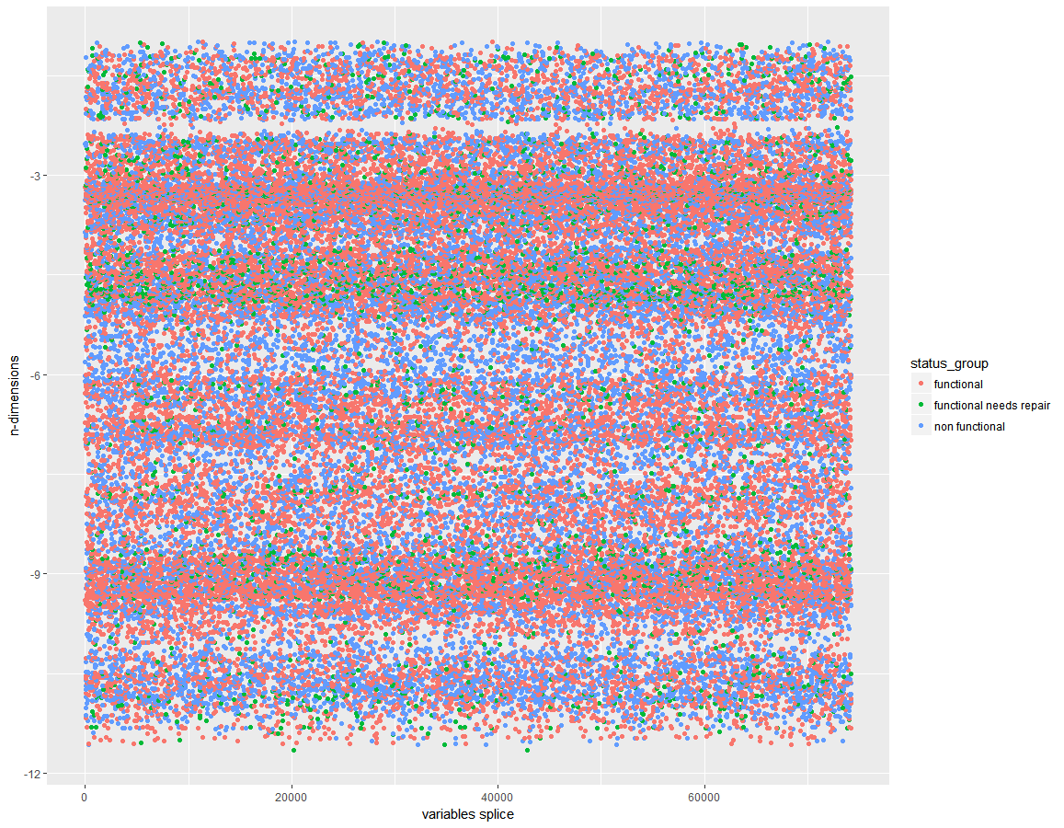
The third category…

Slide 13
Conclusions…
Data cleaning is essential for machine learning projects
Augmenting data with additional external sources can be beneficial
Optimising models & playing with parameters can have a sizeable impact
However sometimes poor data input quality can make analysis difficult
(The ‘functional but needs prepares’ category is essentially just noise)
Predictive analytics can play a key role in making foreign aid and humanitarian operations more effective

